Slide 1
CSS-Responsive Web Design
Dr Govindha Ramaiah Yeluripati

Slide 2
Outline
RWD Introduction
Viewport Meta Tag
Need for RWD
Gridview
Media Queries
Responsive Images
HTML <picture> element
Responsive Videos

Slide 3
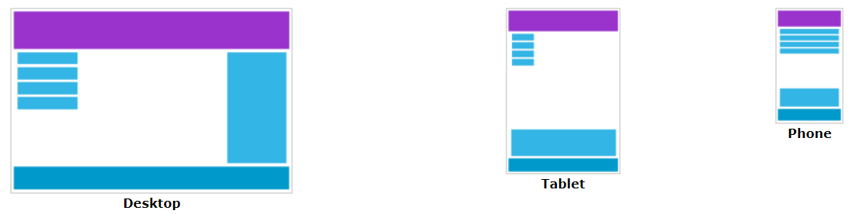
Responsive Web Design-What is it?
Responsive Web Design (RWD) is an approach to web development where websites are designed to respond and adapt to different screen sizes and device types (such as desktops, tablets, and smartphones) to provide an optimal viewing experience.

Slide 4
Responsive Web Design
Makes web pages look good on all devices.
Uses only HTML and CSS.
Not a program or a JavaScript.

Slide 5
Responsive Web Design
Makes web pages look good on all devices.
Uses only HTML and CSS.
Not a program or a JavaScript.

Slide 6
Viewport and Early Web Design
The viewport is the user's visible area of a web page.
Early web designs used fixed-size layouts (typically set in pixels) designed for desktop monitors and didn’t adapt well to smaller devices like tablets and smartphones.
When users accessed these websites on mobile devices, the pages appeared too large, leading to a poor user experience.
To handle fixed-size web pages on smaller screens, mobile browsers automatically scaled down the entire page to fit the viewport. This process is called viewport scaling.

Slide 7
The Solution: RWD and Viewport Meta Tag
HTML5 introduced a method to let web designers take control over the viewport, through the <meta> tag.
Commonly used viewport meta tag in HTML:
This gives the browser instructions on controlling the page's dimensions and scaling.
The width=device-width part sets the page's width to follow the device's screen-width (which will vary depending on the device).
The initial-scale=1.0 part sets the initial zoom level when the browser first loads the page.

Slide 8

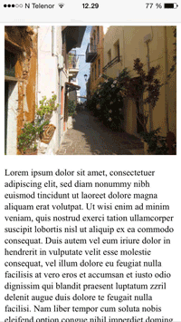
Viewport meta tag effect: Example

Slide 9
Is the meta tag alone sufficient for RWD?
The viewport meta tag (like width=device-width) primarily tells the browser:
  To stop automatically scaling down the page to fit small devices.
  To set the viewport width to the device's actual width and maintain an initial scale (zoom level).
However, the meta tag alone doesn’t make the content flexible—it just stops the browser from doing any automatic resizing.

Slide 10
Need of CSS for RWD
While the <meta> tag sets the correct initial scale, it doesn't adjust the layout, fonts, images, etc. for different screen sizes.
For true responsive web design, CSS is essential because it:
  Controls the layout, ensuring content rearranges or resizes smoothly on various screen sizes (using flexible grids and flexboxes)
  Adapts styles using media queries, which apply different styles (text size, hide/show elements, change layout, or adjust margin) based on the screen size or orientation.
  Improves usability by adjusting text (typography scaling), images (fluid image), spacing and padding for readability and interactivity.

Slide 11
A note on modern browsers behavior
Modern mobile browsers are designed to provide a decent user experience even for non-responsive web pages (e.g., no meta tag)
They do this by:
  Automatically zooming out and scaling the page to fit the device’s screen width.
  Applying default behavior to scale or adjust layouts to prevent content overflow.
Automatic/default behavior is not a substitute for proper responsive design.

Slide 12
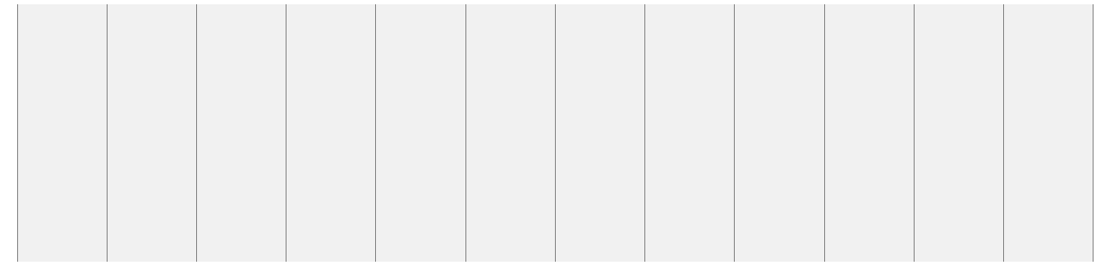
RWD: Grid-View
Many web pages are based on a grid-view, which means that the page is divided into columns.
A responsive grid-view often has 12 columns, and has a total width of 100%, and will shrink and expand as the browser window is resized.

Slide 13
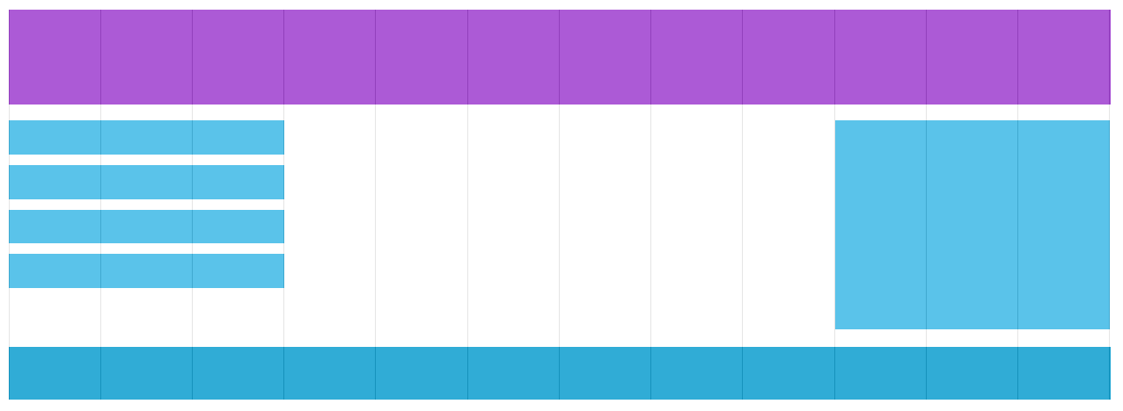
RWD: Grid-View
Grid-view makes it easier to place elements on the page.
Example from the w3Schools

Slide 14

Building a Responsive Grid-View
First ensure that all HTML elements have the box-sizing property set to border-box. This makes sure that the padding and border are included in the total width and height of the elements.
Add the following code in the CSS:

Slide 15
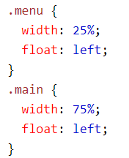
Building a Responsive Grid-View
An example with two columns:

Slide 16
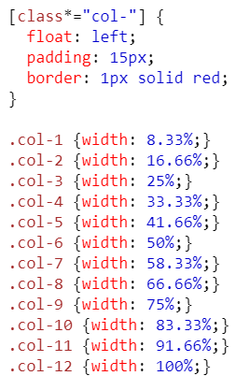
Responsive Grid-View
To have more control over the web page, we may want to use a responsive grid-view with 12 columns.
The percentage for one column: 100% / 12 columns = 8.33%.
Make one class for each of the 12 columns, using class="col-" and a number defining how many columns the section should span.
All these columns should be floating to the left, and have a padding of 15px

Slide 17
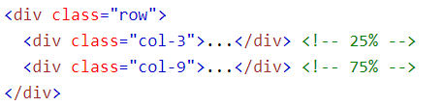
Responsive grid-view
Each row should be wrapped in a <div>.
The number of columns inside a row should always add up to 12

Slide 18
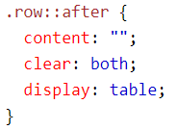
Responsive grid-view
The columns inside a row are all floating to the left and are therefore taken out of the flow of the page, and other elements will be placed as if the columns do not exist.
To prevent this, we will add a style that clears the flow:
This is called, clearfix
This ensures that:
The .row expands its height to contain its floated columns, wrapping around them.
The layout behaves as expected, preventing overlapping or layout issues.

Slide 19
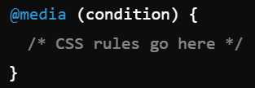
RWD-Media Queries
Media query is a CSS technique introduced in CSS3.
It uses the @media rule to include a block of CSS properties only if a certain condition is true.
The conditions are based on the characteristics of the device such as screen size, resolution, or orientation.
Media queries allow the layout of the web pages to adjust looking good on different devices like phones, tablets, and desktops.
Syntax:

Slide 20
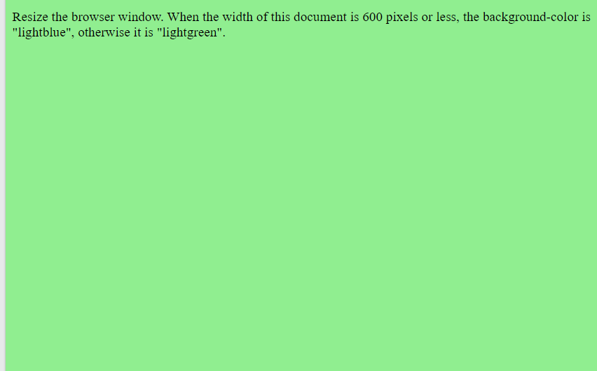
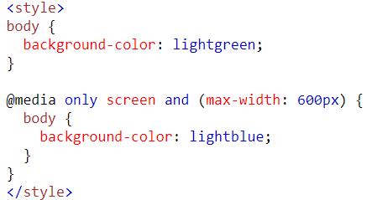
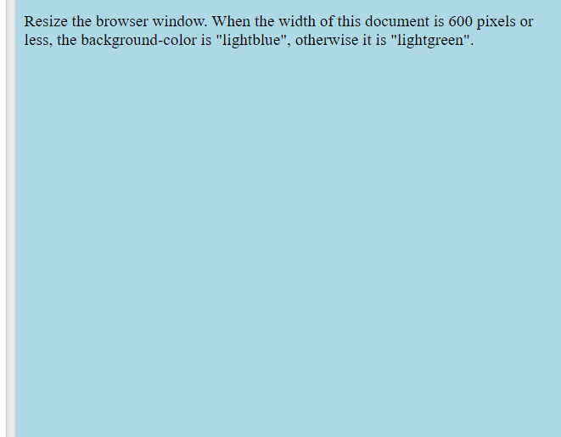
Most Common Conditions: Screen Width
In this example, the style is applied when the size of the screen is less than 600px wide
'only screen' is optional and is for backward compatibility with older browsers

Slide 21
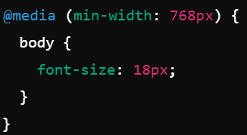
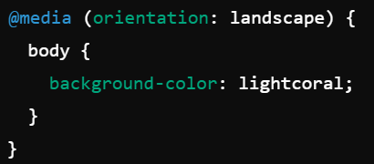
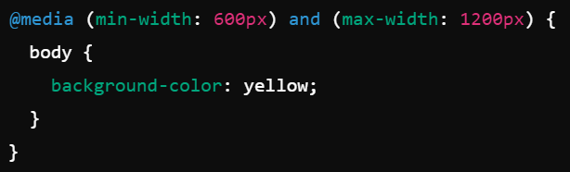
Other Common Media Query Conditions
Styles apply when the screen width is at least 768px
The text size will be larger for screens wider than 768px (such as tablets or desktops).
This changes the background to light coral if the device is in landscape mode.
This will apply the background color of yellow only when the screen is between 600px and 1200px wide.

Slide 22
Logical Operators in Media Queries
and: All conditions must be true
not: Applies styles when the condition is false
only: Targets specific devices and prevents older browsers from applying styles
Comma (,): Works like "or" logic-applies styles if any condition is true.

Slide 23
Typical device breakpoints
There are tons of screens and devices with different heights and widths, so it is hard to create an exact breakpoint for each device. To keep things simple, we could target five groups:
/* Extra small devices (phones, 600px and down) */
@media only screen and (max-width: 600px) {...}
/* Small devices (portrait tablets and large phones, 600px and up) */
@media only screen and (min-width: 600px) {...}
/* Medium devices (landscape tablets, 768px and up) */
@media only screen and (min-width: 768px) {...}
/* Large devices (laptops/desktops, 992px and up) */
@media only screen and (min-width: 992px) {...}
/* Extra large devices (large laptops and desktops, 1200px and up) */
@media only screen and (min-width: 1200px) {...}

Slide 24
RWD-Images
If the width property is set to a percentage and the height property is set to "auto", the image will be responsive and scale up and down
Example: img {
width: 100%;
height: auto;
}
If the max-width property is set to 100%, the image will scale down if it has to but never scale up larger than its original size.
Example: img {
width: 100%;
height: auto;
}

Slide 25
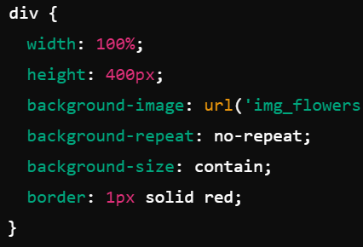
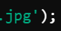
RWD-Background Images
If the background-size property is set to "contain", the background image will scale and try to fit the content area keeping its aspect ratio (the proportion of the image's width and height)
The div takes up 100% of the available width of its container
The div has a fixed height of 400px
The background image used is 'img_flowers.jpg'
The image will not repeat (i.e., no tiling)
The image will scale to fit within the div while maintaining its aspect ratio
The div will have a 1px red border around it

Slide 26
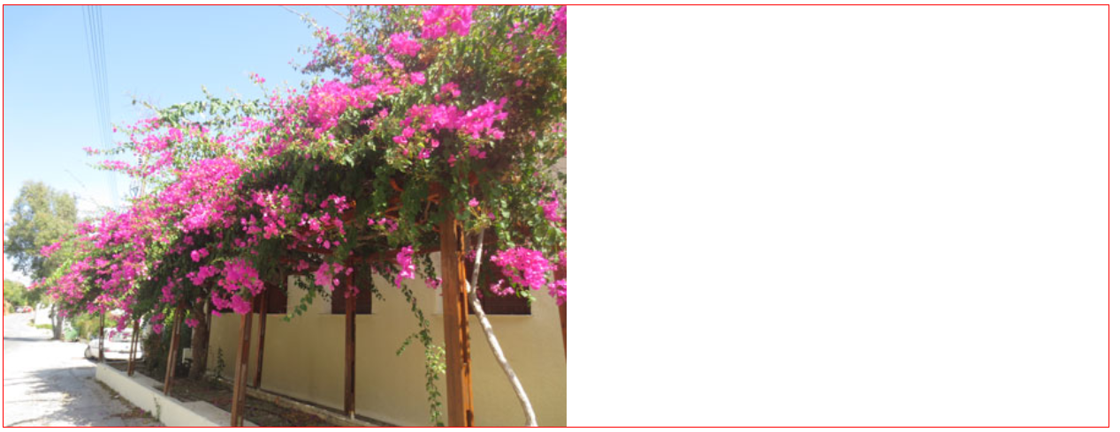
RWD-Background Images
Effect of the example style on the previous slide:

Slide 27
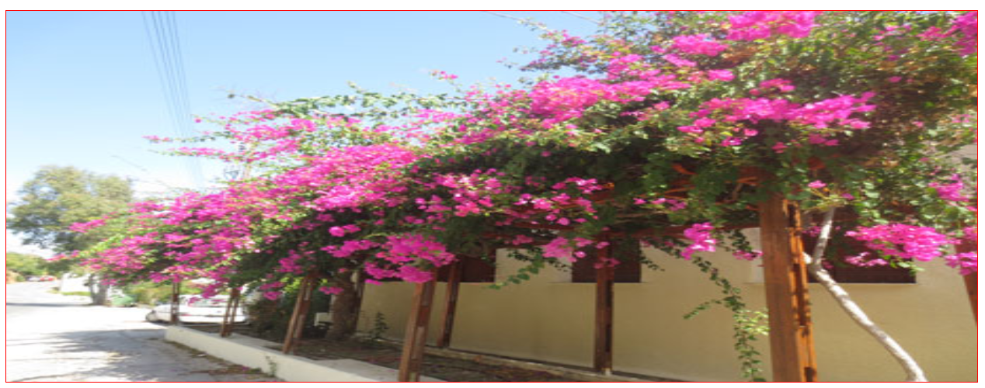
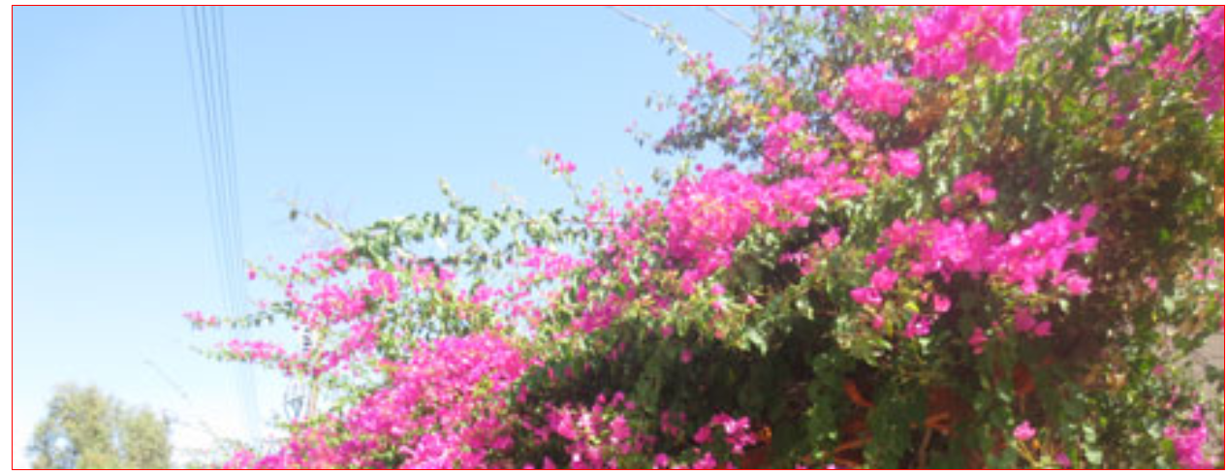
RWD-Background Images
Other values for the background size:
If the background-size property is set to "100% 100%", the background image will stretch to cover the entire content area
If the background-size property is set to "cover", the background image will scale to cover the entire content area. Some part of the background image may be clipped

Slide 28
Different Images for Different Devices
A large image can be perfect on big screens but useless on a small device. To reduce the load, or for any other reasons, we can use media queries to display different images on different devices.
/* For width smaller than 400px: */
body {
background-image: url('img_smallflower.jpg');
}
/* For width 400px and larger: */
@media (min-width: 400px) {
body {
background-image: url('img_flowers.jpg');
}
}

Slide 29
The HTML <picture> Element
The HTML <picture> element gives web developers more flexibility in specifying image resources.
The most common use of the <picture> element will be for images used in responsive designs. Instead of having one image that is scaled up or down based on the viewport width, multiple images can be designed to more nicely fill the browser viewport.
The <picture> element works similarly to the <video> and <audio> elements.
We set up different sources, and the first source that fits the preferences will be the one used

Slide 30
The HTML <picture> Element
<picture>
<source srcset="img_smallflower.jpg" media="(max- width: 400px)">
<source srcset="img_flowers.jpg">
<img src="img_flowers.jpg" alt="Flowers">
</picture>
The srcset attribute is required and defines the source of the image.
The media attribute is optional and accepts the media queries we use in the CSS @media rule.
We should also define an <img> element for browsers that do not support the <picture> element.

Slide 31
RWD-Videos
If the width property is set to 100%, the video player will be responsive and scale up and down
Example: video {
width: 100%;
height: auto;
}
If the max-width property is set to 100%, the video player will scale down if it has to but never scale up to be larger than its original size
Example: video {
max-width: 100%;
height: auto;
}

Slide 32
Thank you
Questions???
Govindha Yeluripati

